Slide 1
ELEC5566M FPGA Design for System-on-Chip
Unit 1.2
Prof Steven Freear Module Leader s.freear@leeds.ac.uk
Dr David Cowell

Slide 2
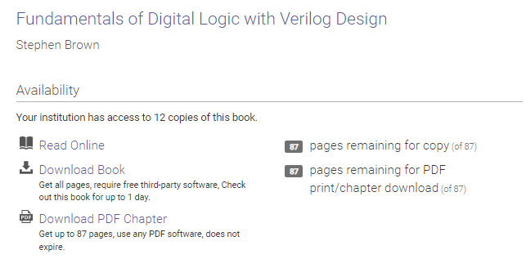

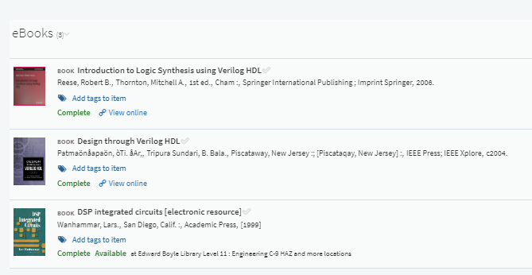
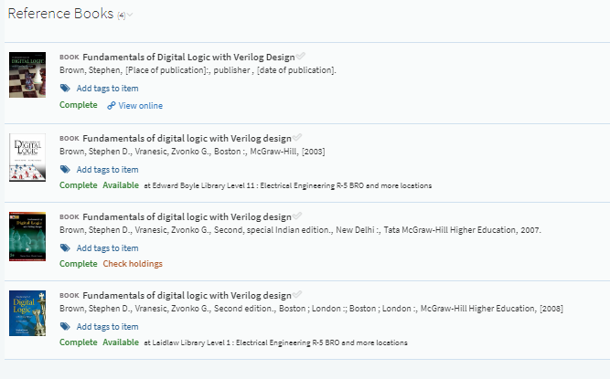
Reading List - reminder

Slide 3
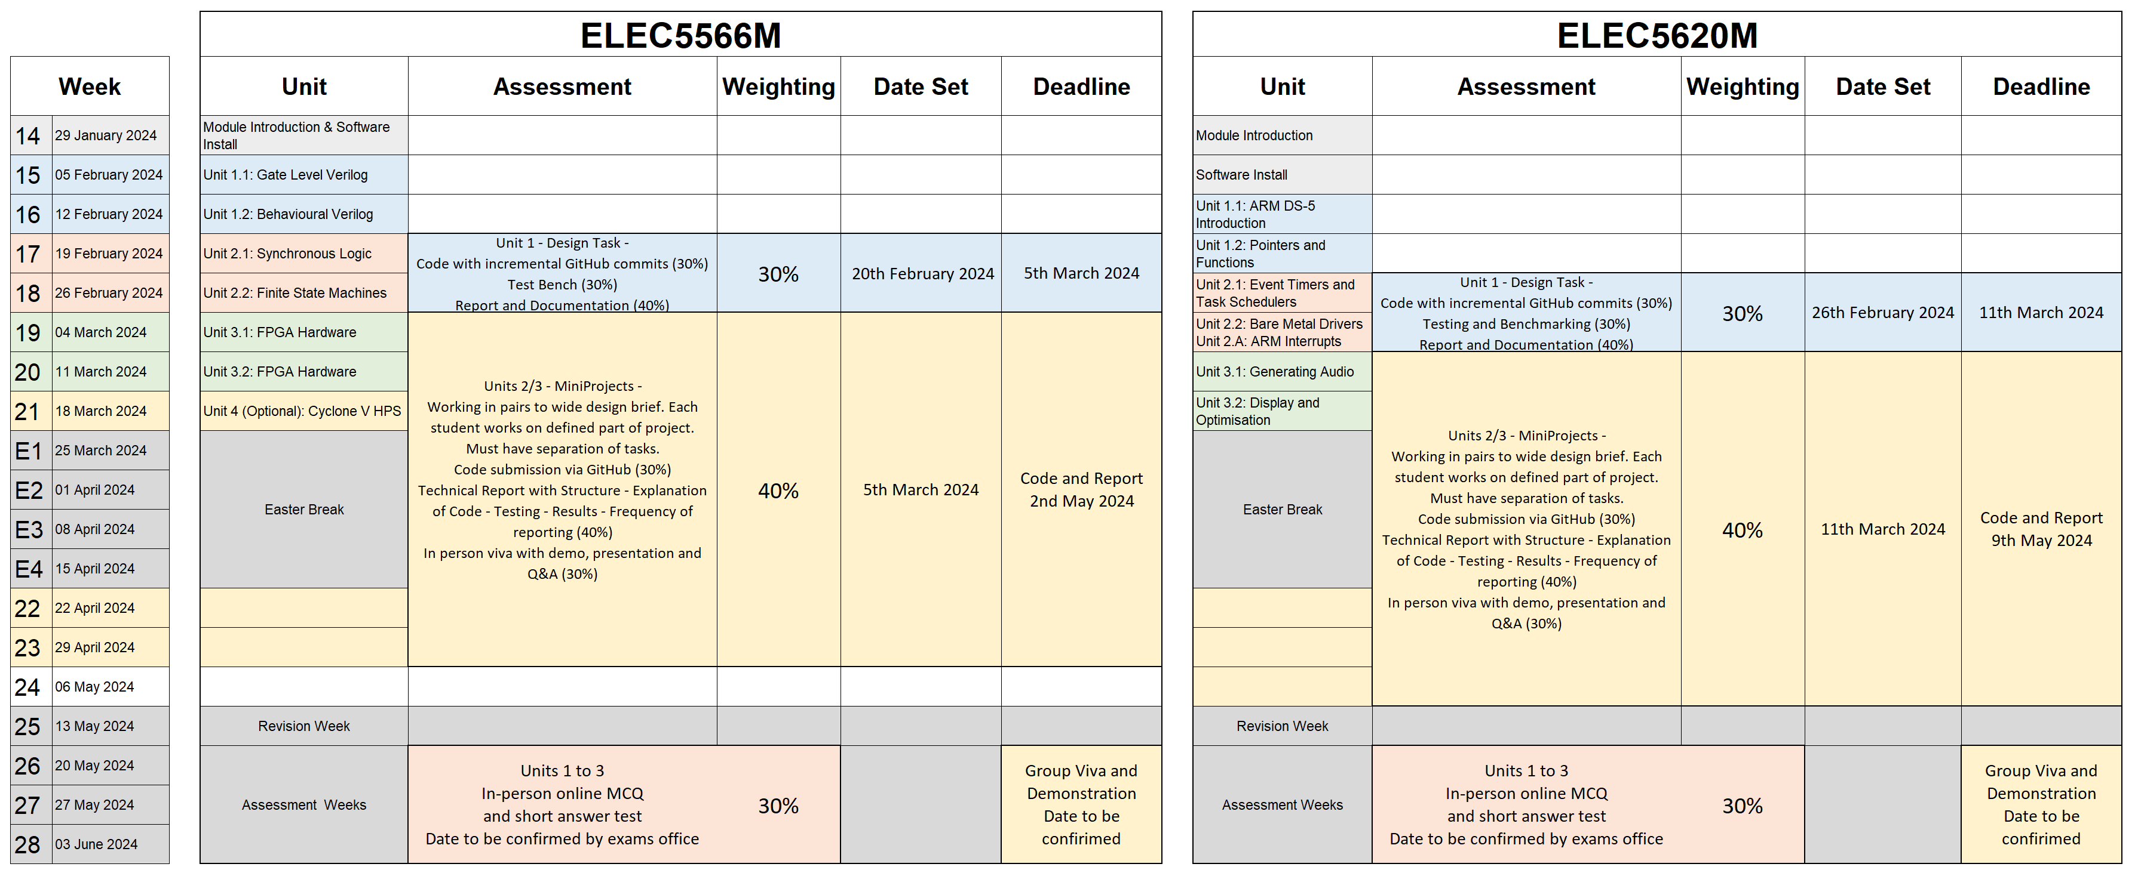
Assessment Summary – ELEC5566 Assessment Summary

Slide 4
Unit 1.1 Task Review

Slide 5
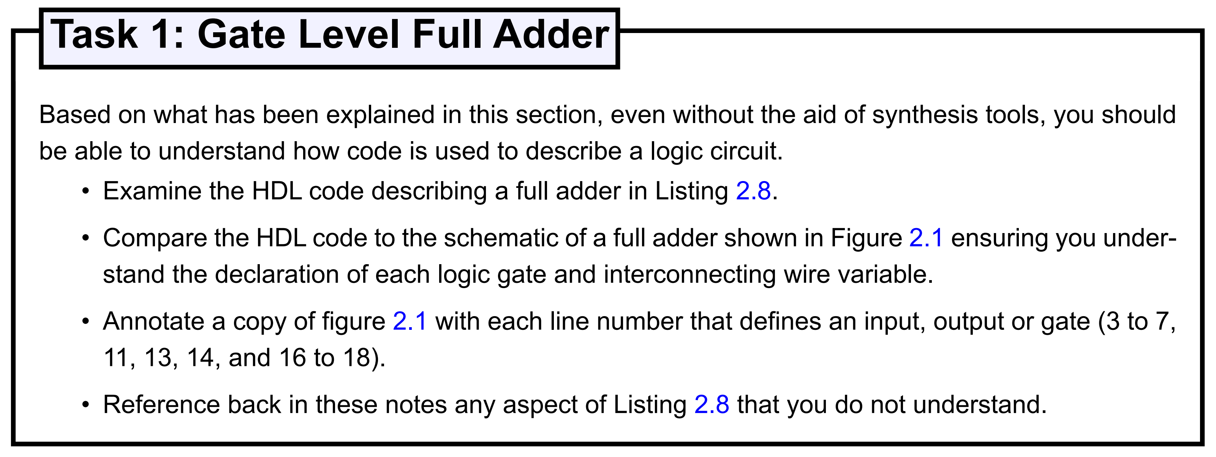
Unit 1.1 Task 1 Review

Slide 6
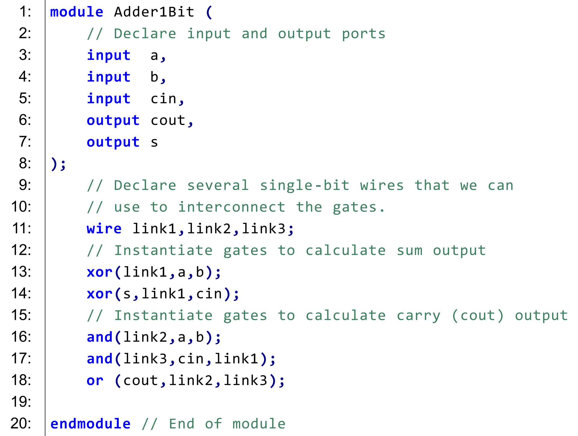
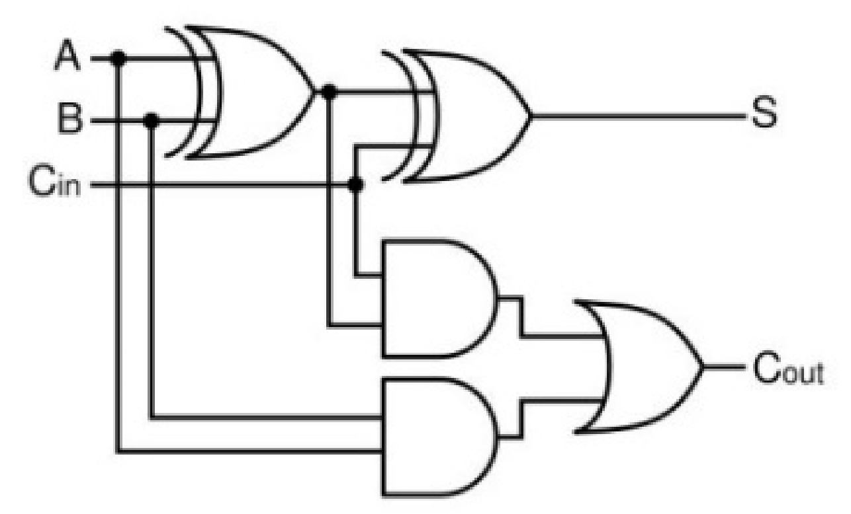
Unit 1.1 Task 1 Review
3:
link1
7:
13:
4:
14:
5:
link3
17:
6:
18:
16:
link2

Slide 7
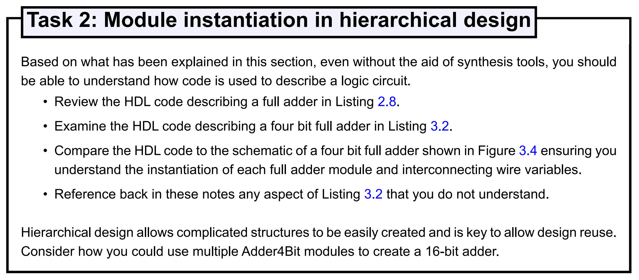
Unit 1.1 Task Review

Slide 8
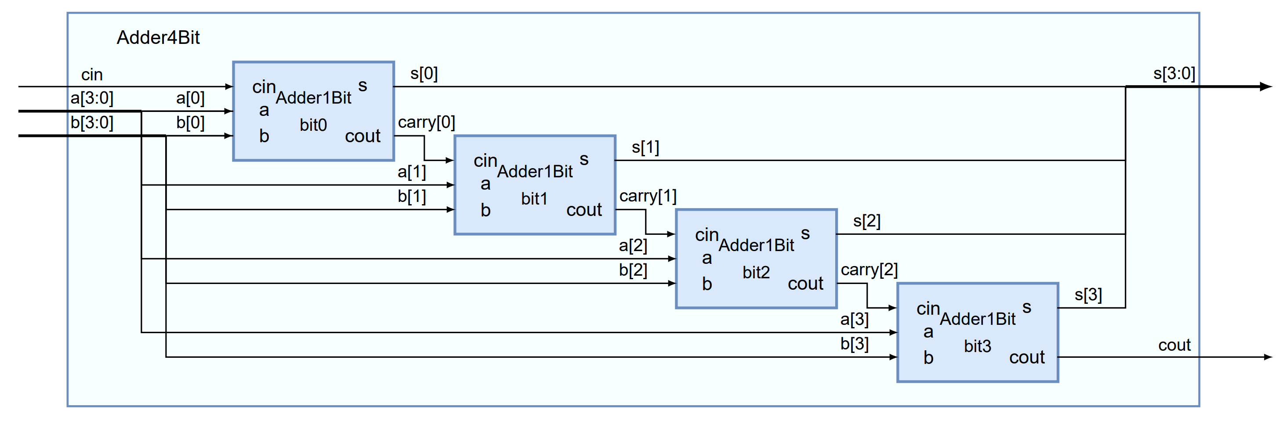
Unit 1.1 Task Review
16
4
3:0
15:0
15:0
15:0
3:0
nibble
4
7:4
7:4
nibble
4
11:8
11:8
nibble
4
15:12
15:12
nibble

Slide 9
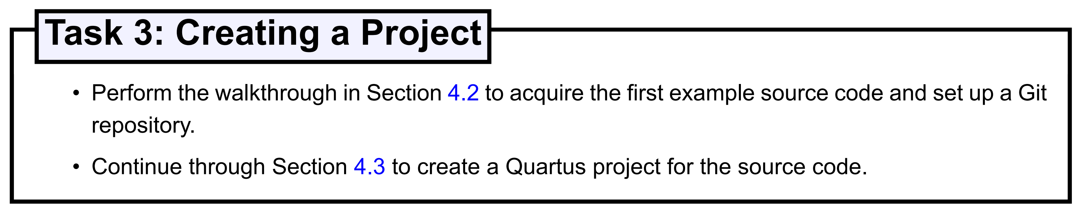
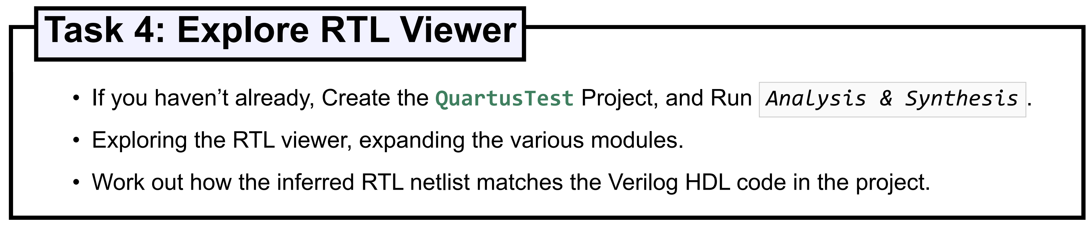
Unit 1.1 Task Review

Slide 10
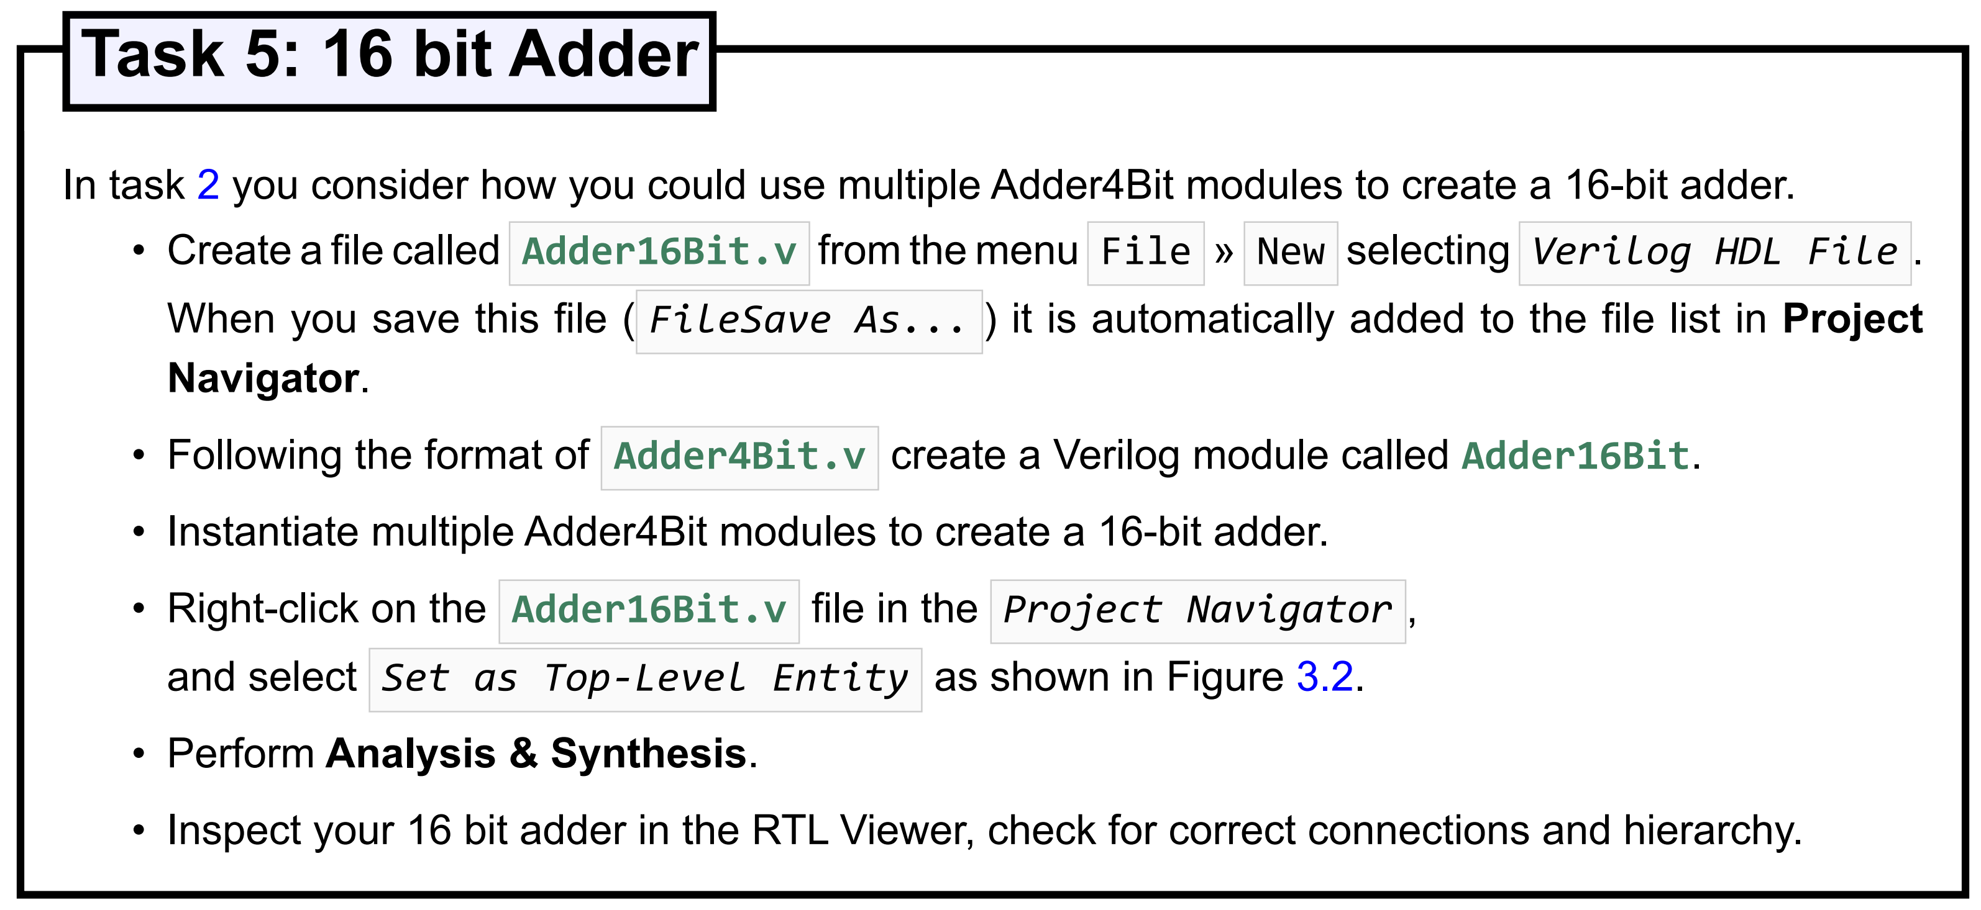
Unit 1.1 Task Review

Slide 11
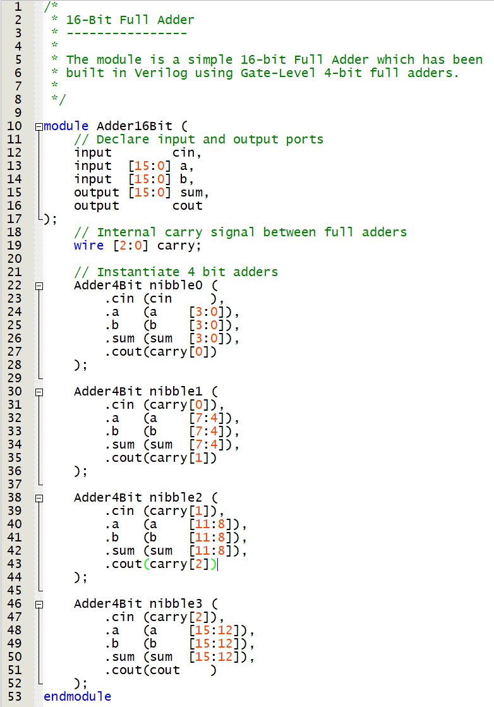
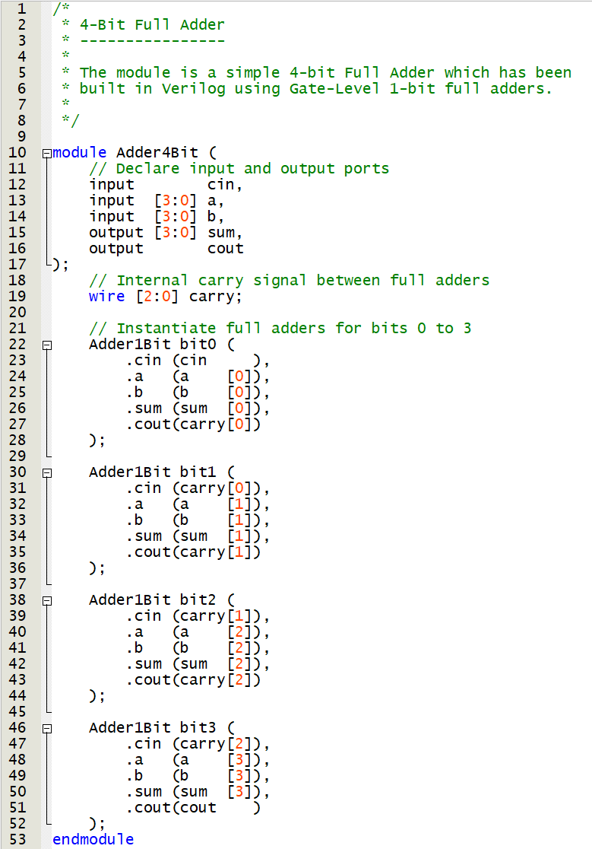
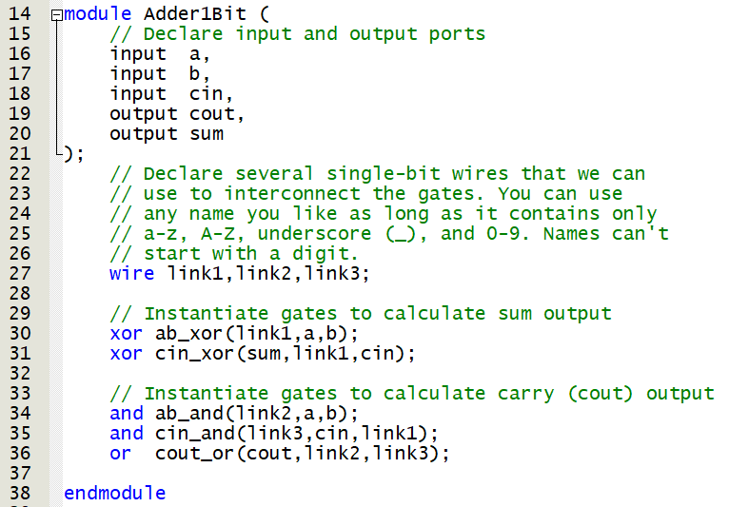

Slide 12
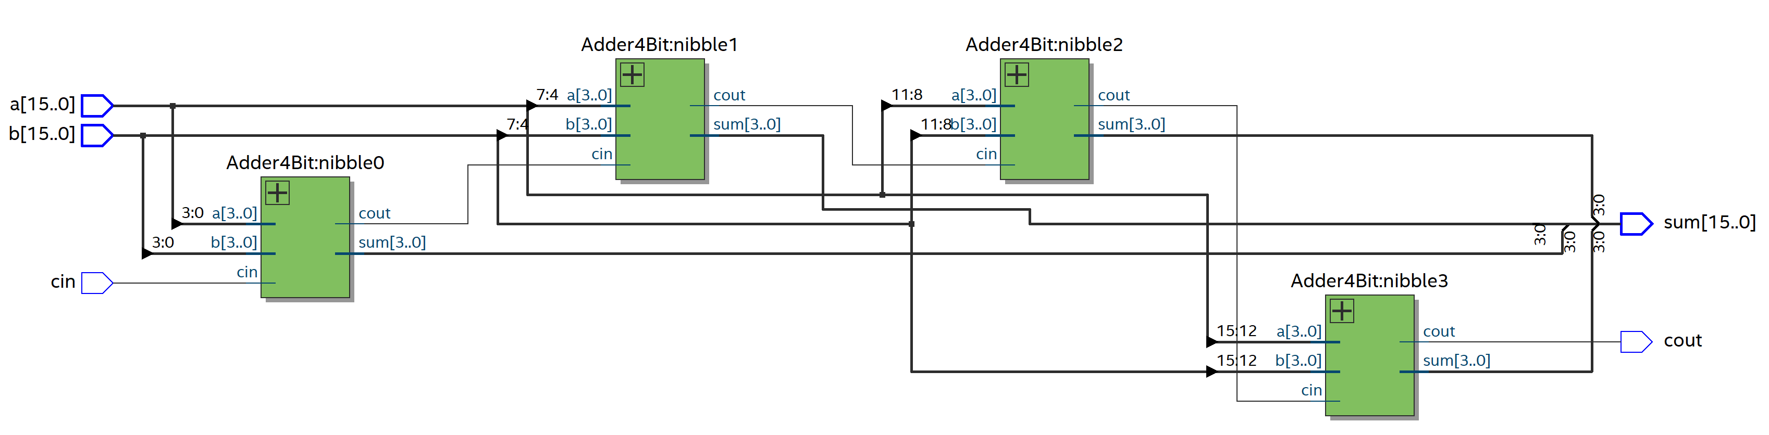
RTL Viewer

Slide 13
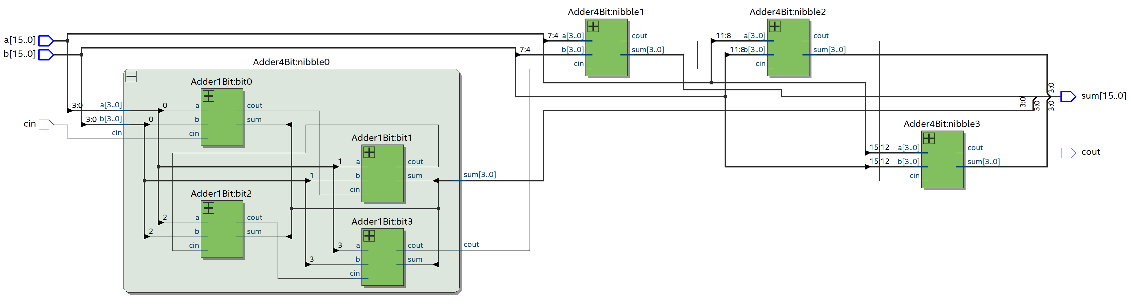
RTL Viewer

Slide 14
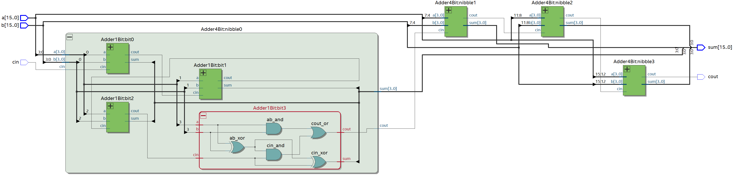
RTL Viewer

Slide 15
Unit 1.2

Slide 16
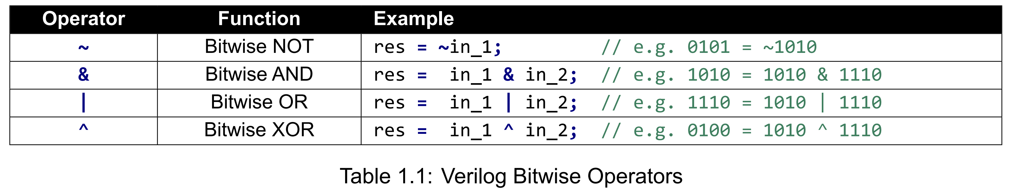
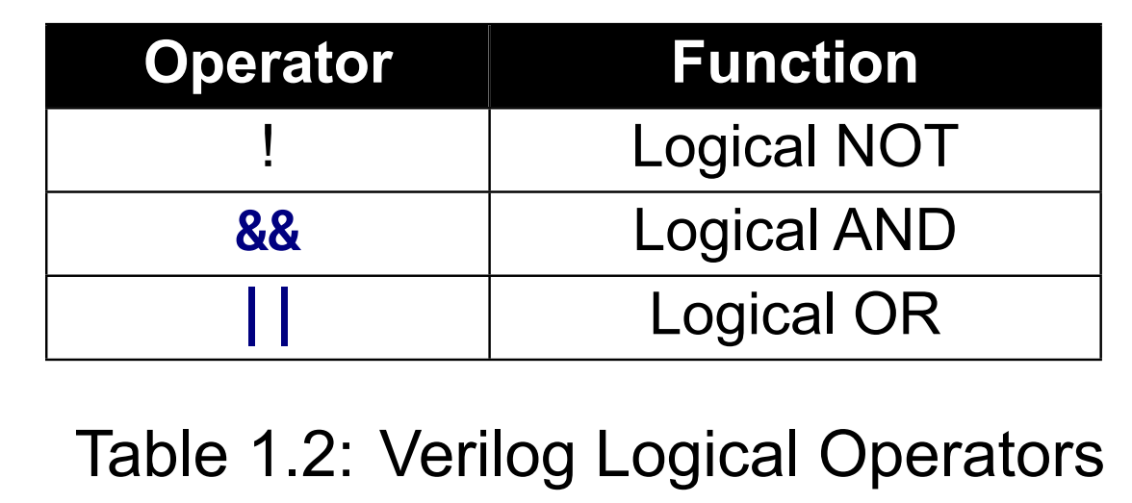
Bitwise vs Logical Operators
Logical operators operate on the value as a whole, not bit by bit.
Result is a single bit wide regardless of the operand width.
Non-zero input is true, while zero input is false.

Slide 17
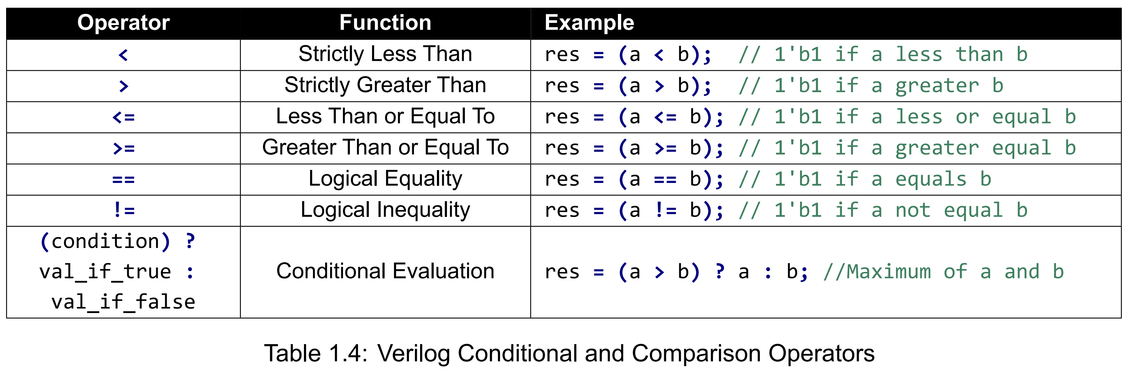
Comparison and Conditional Operators

Slide 18
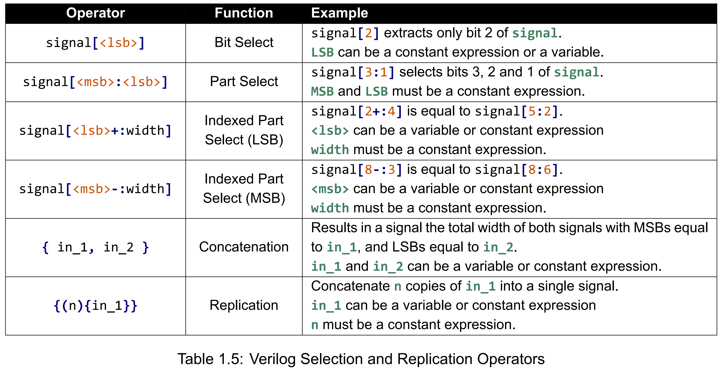
Selection and Replication Operators
wire s = 8’b10101101;
s[1] 1’b 0 ;
s[2:0] 3’b 101;
s[2+:2] 2’b 11 ;
s[2-:2] 2’b 10 ;
wire in_1 = 2’b01;
wire in_2 = 2’b10;
{in_1, in_2} = 4’b0110
{(2){in_1}} = 4’b0101;

Slide 19
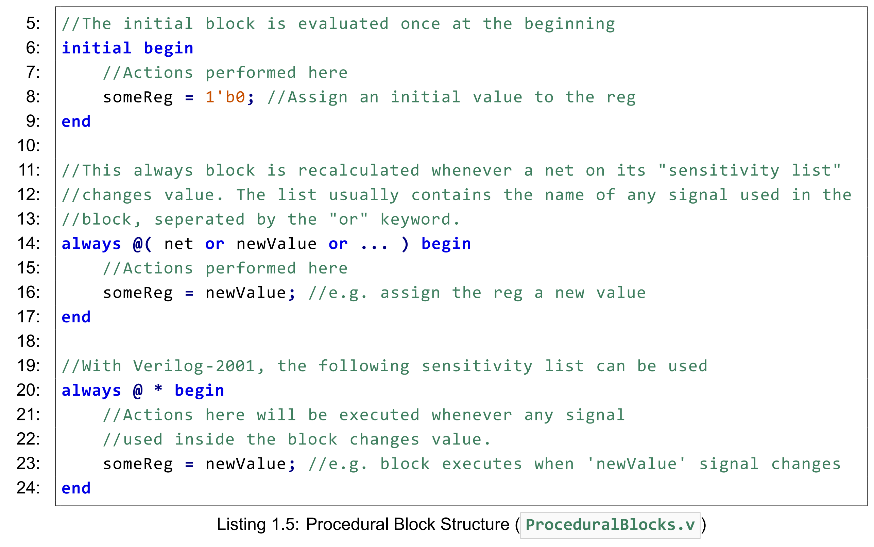
Procedural Assignment
Two types of procedural block,
the initial block, and the always block.
The initial block performs its actions exactly once either when a simulation begins, or when the FPGA is configured.
The always block performs its actions every time an event occurs.

Slide 20
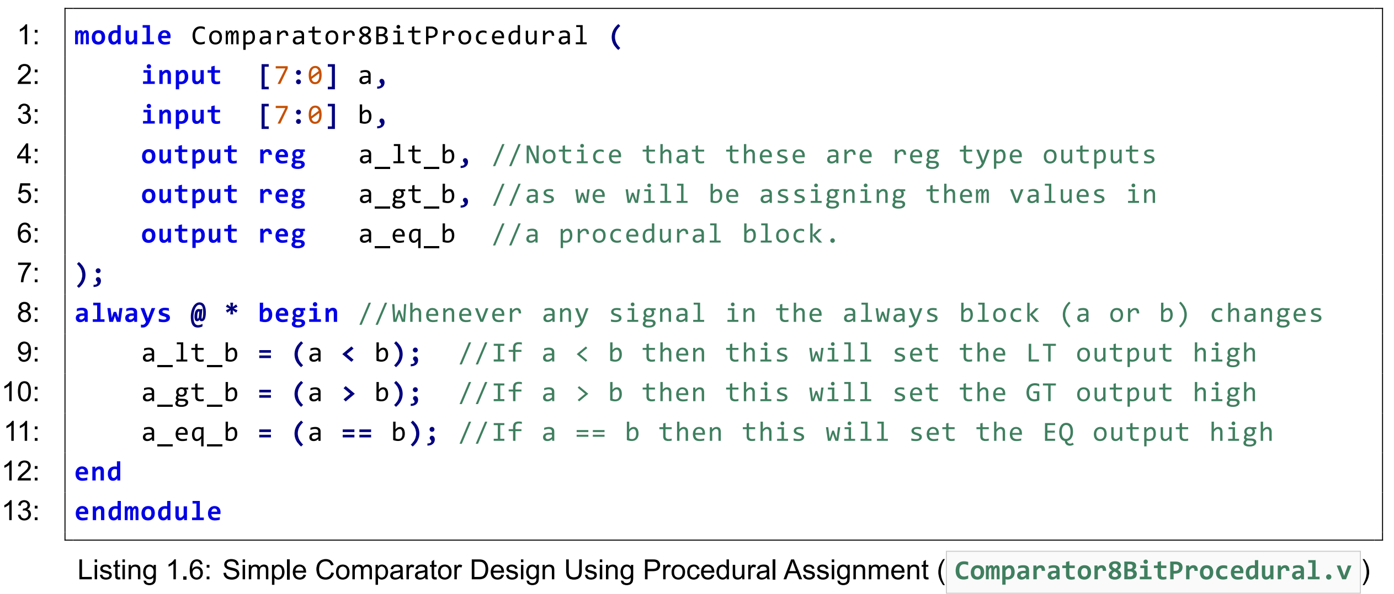
Behavioural Verilog Operators

Slide 21
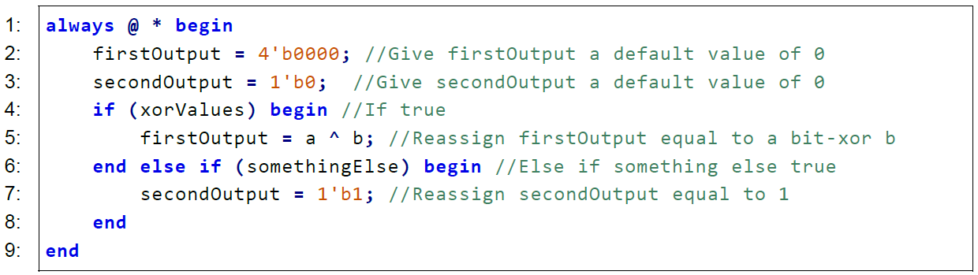
Procedural Verilog If - else
You can nest if-else statements to create complicated procedures.

Slide 22
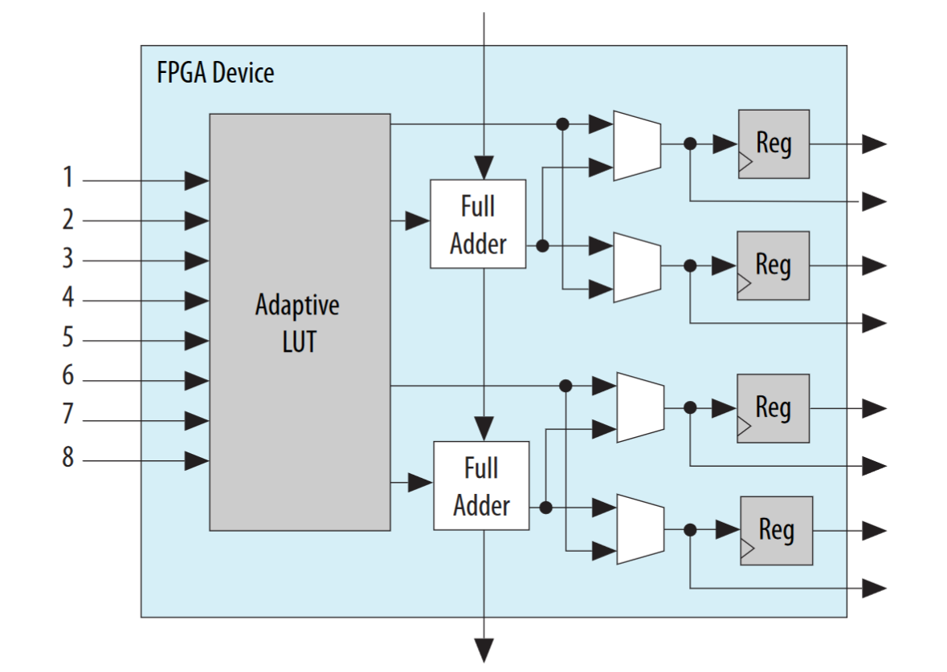
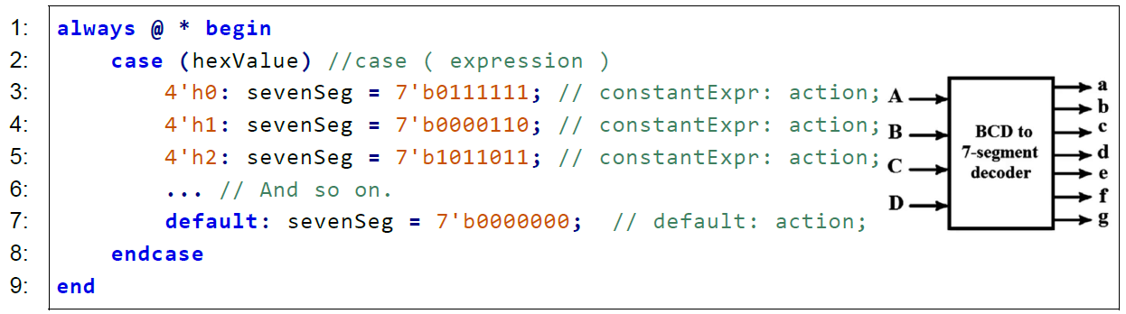
Verilog Case Statements
Equivalent to c switch statement
‘Simple’ case statement maps well to LUT in FPGA fabric.
Task: How many Adaptive LUTs are required to implement a HEX to 7-seg display?

Slide 23
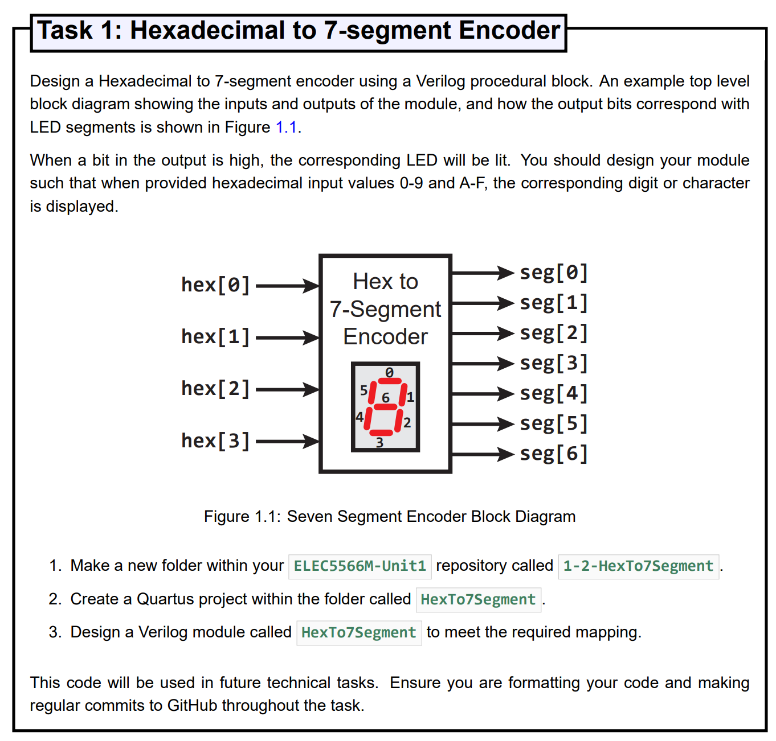
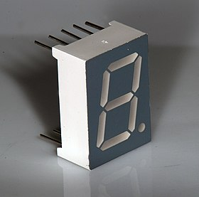


https://en.wikipedia.org/wiki/Seven-segment_display

Slide 24
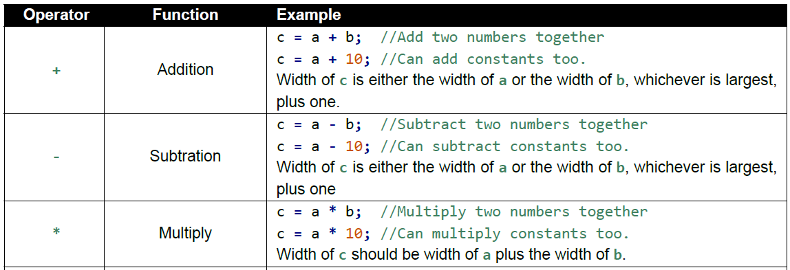
Advanced Operators
Q: Why did we design a 2x3 bit multiplier when we could use p=m*q ?

Slide 25
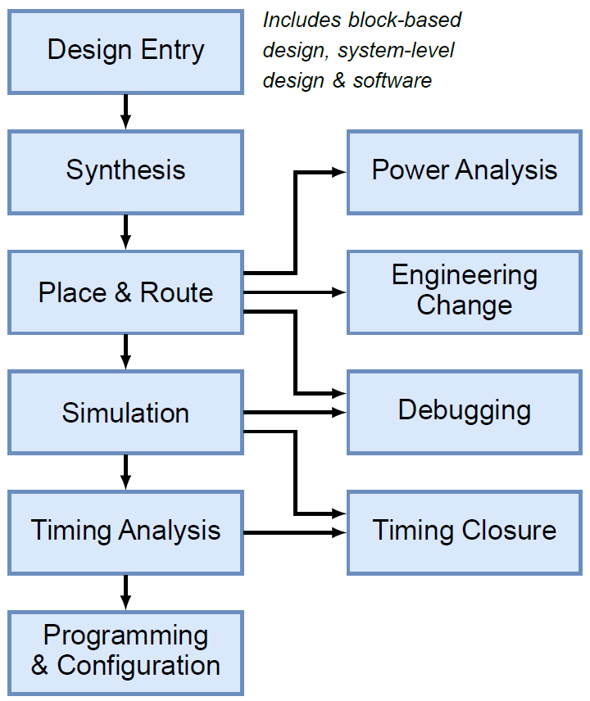
FPGA Design Flow
10% effort
90% effort

Slide 26
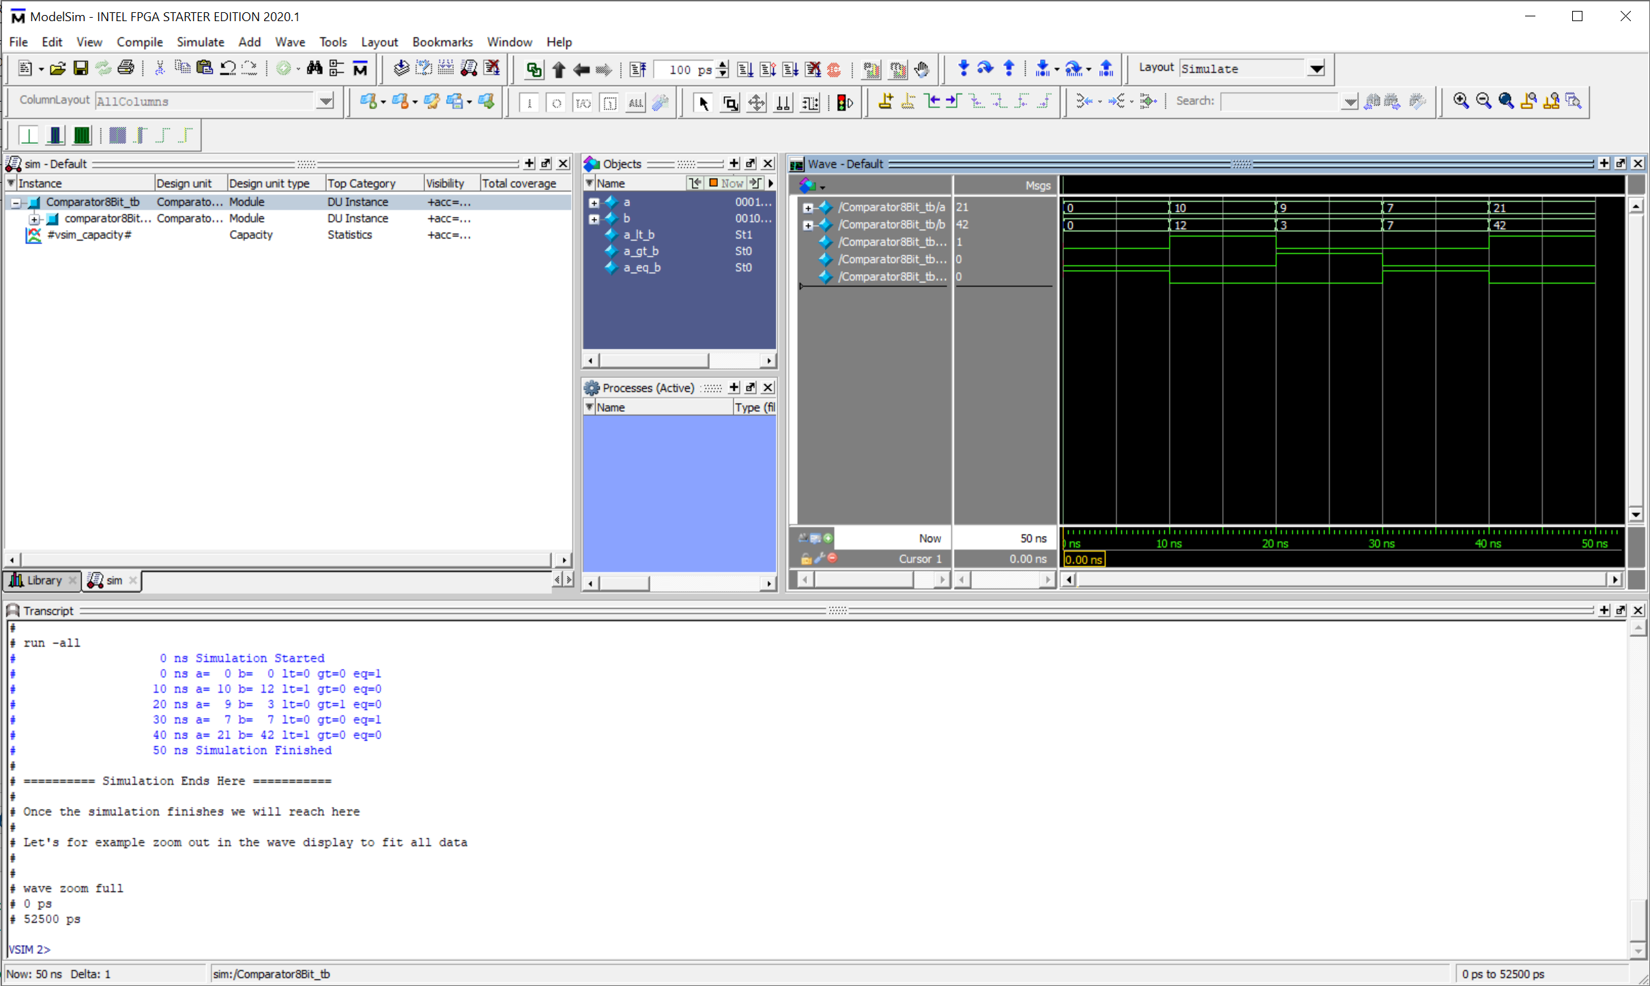
FPGA EDA Tools – Simulation
Supply circuit with input, view simulated output - Isolated test bench to exercise a Verilog HDL module
Circuit inputs specified using Verilog test benches. - Text based – Easy to modify between projects
Functional Simulation
Is my implementation functionally correct?
Timing simulation
Can I clock my circuit at X MHz?
Apply inputs
Monitor output
Log results to file

Slide 27
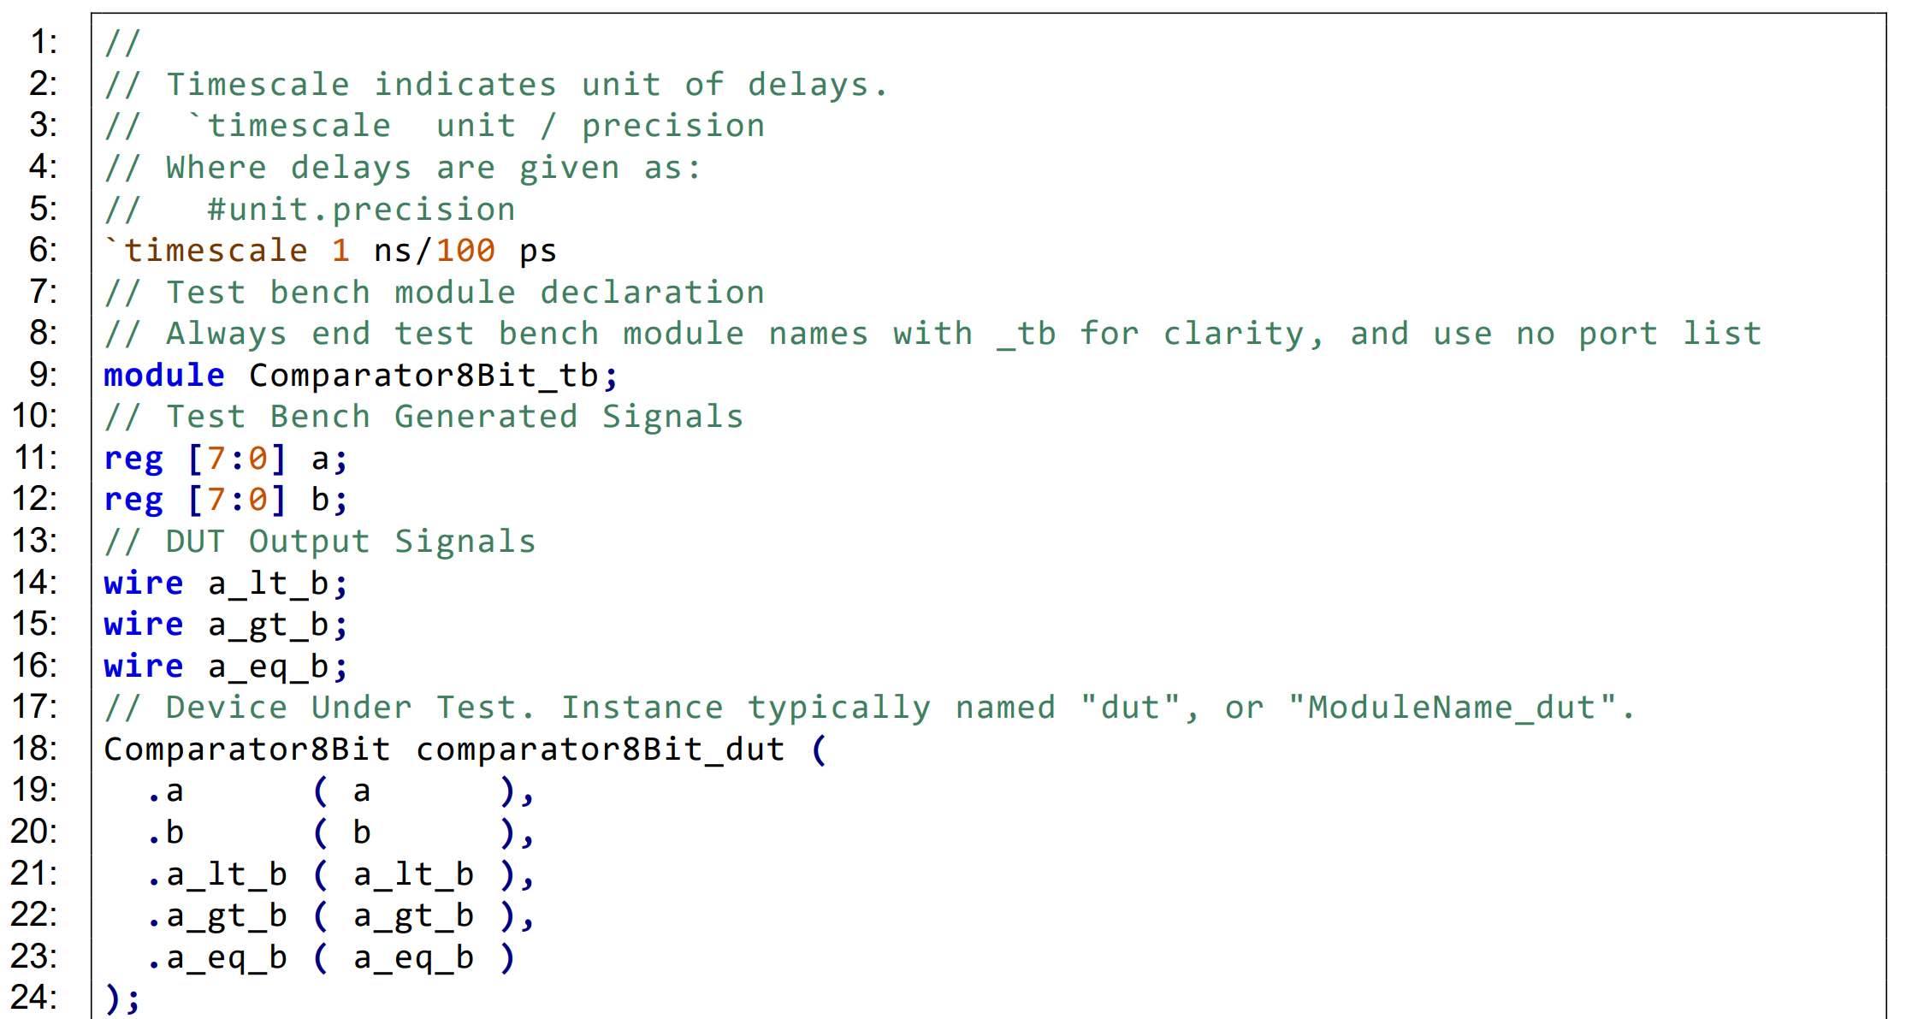
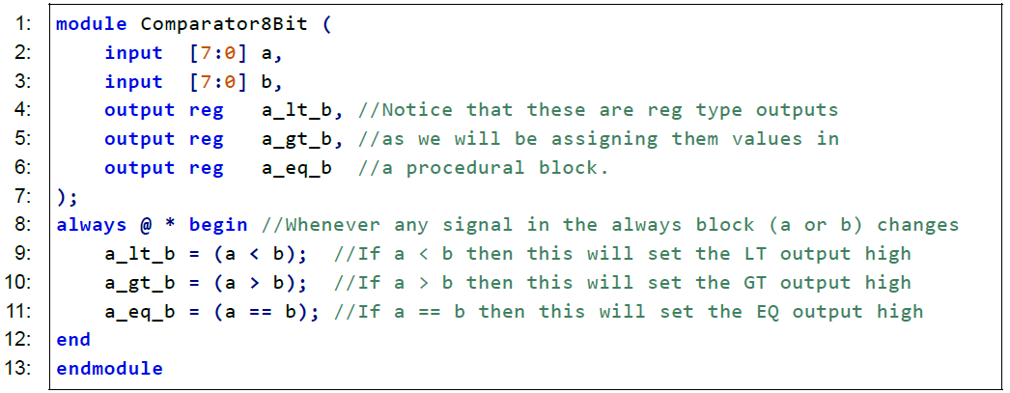
Verilog Test Bench Example Setup
Timescale
Test bench registers (variables)
and connections
Instantiate DUT Verilog modules

Slide 28
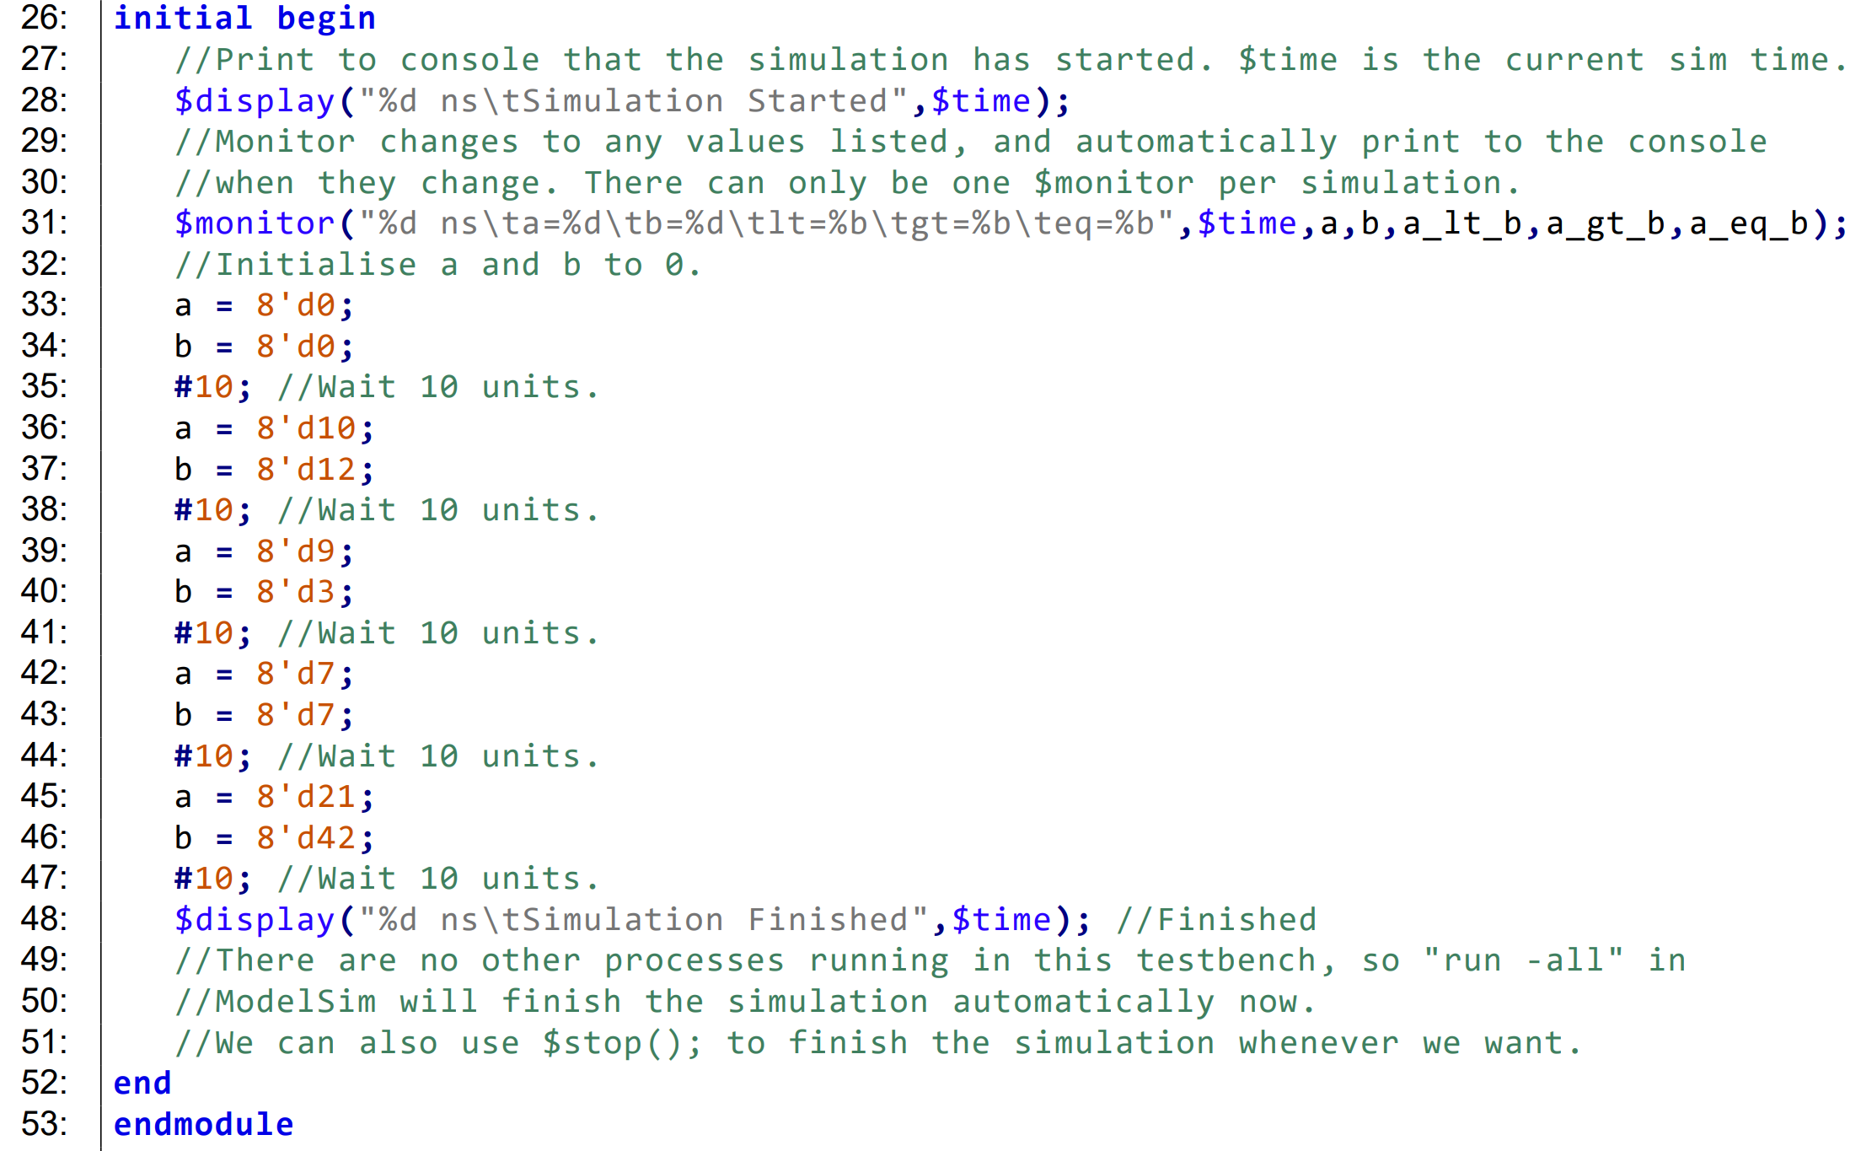
Set initial simulation values
Display logging message
Monitor changes to variables
Define simulation inputs
vs timesteps
Display logging message
End statements and end module

Slide 29
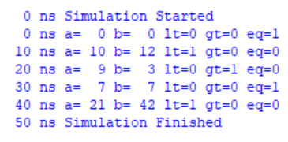
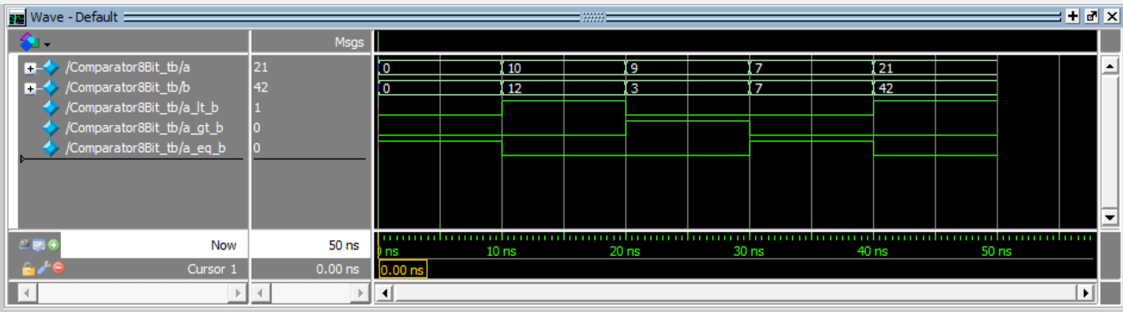
Simulation Outputs

Slide 30
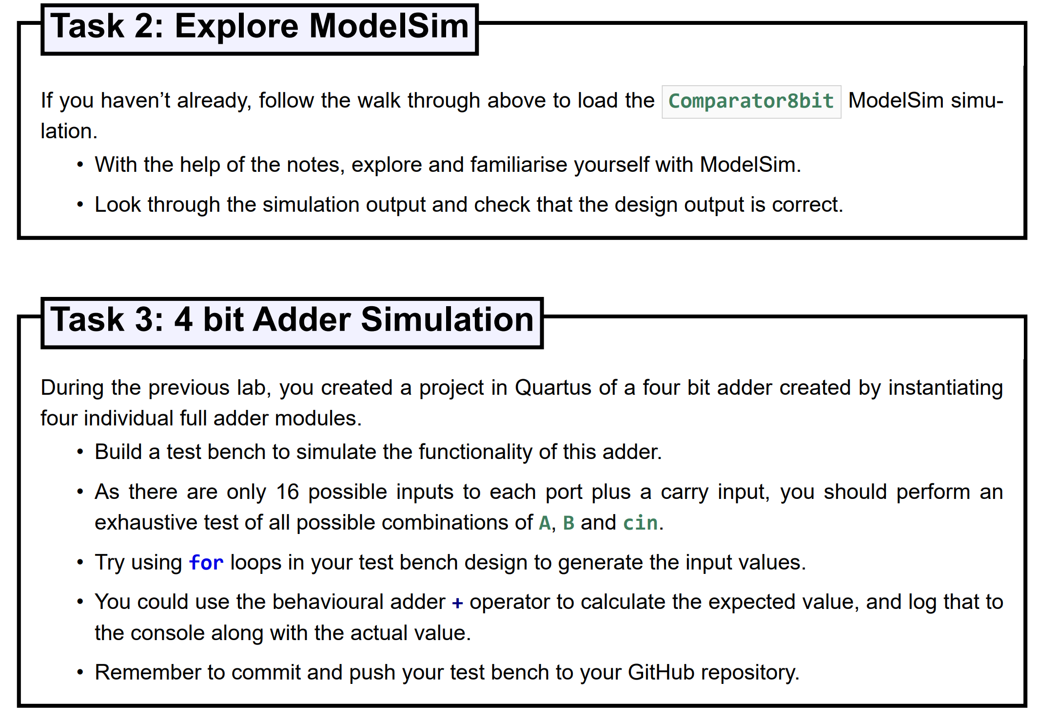

Slide 31
Have fun and enjoy the FPGA module!

